Slide 1
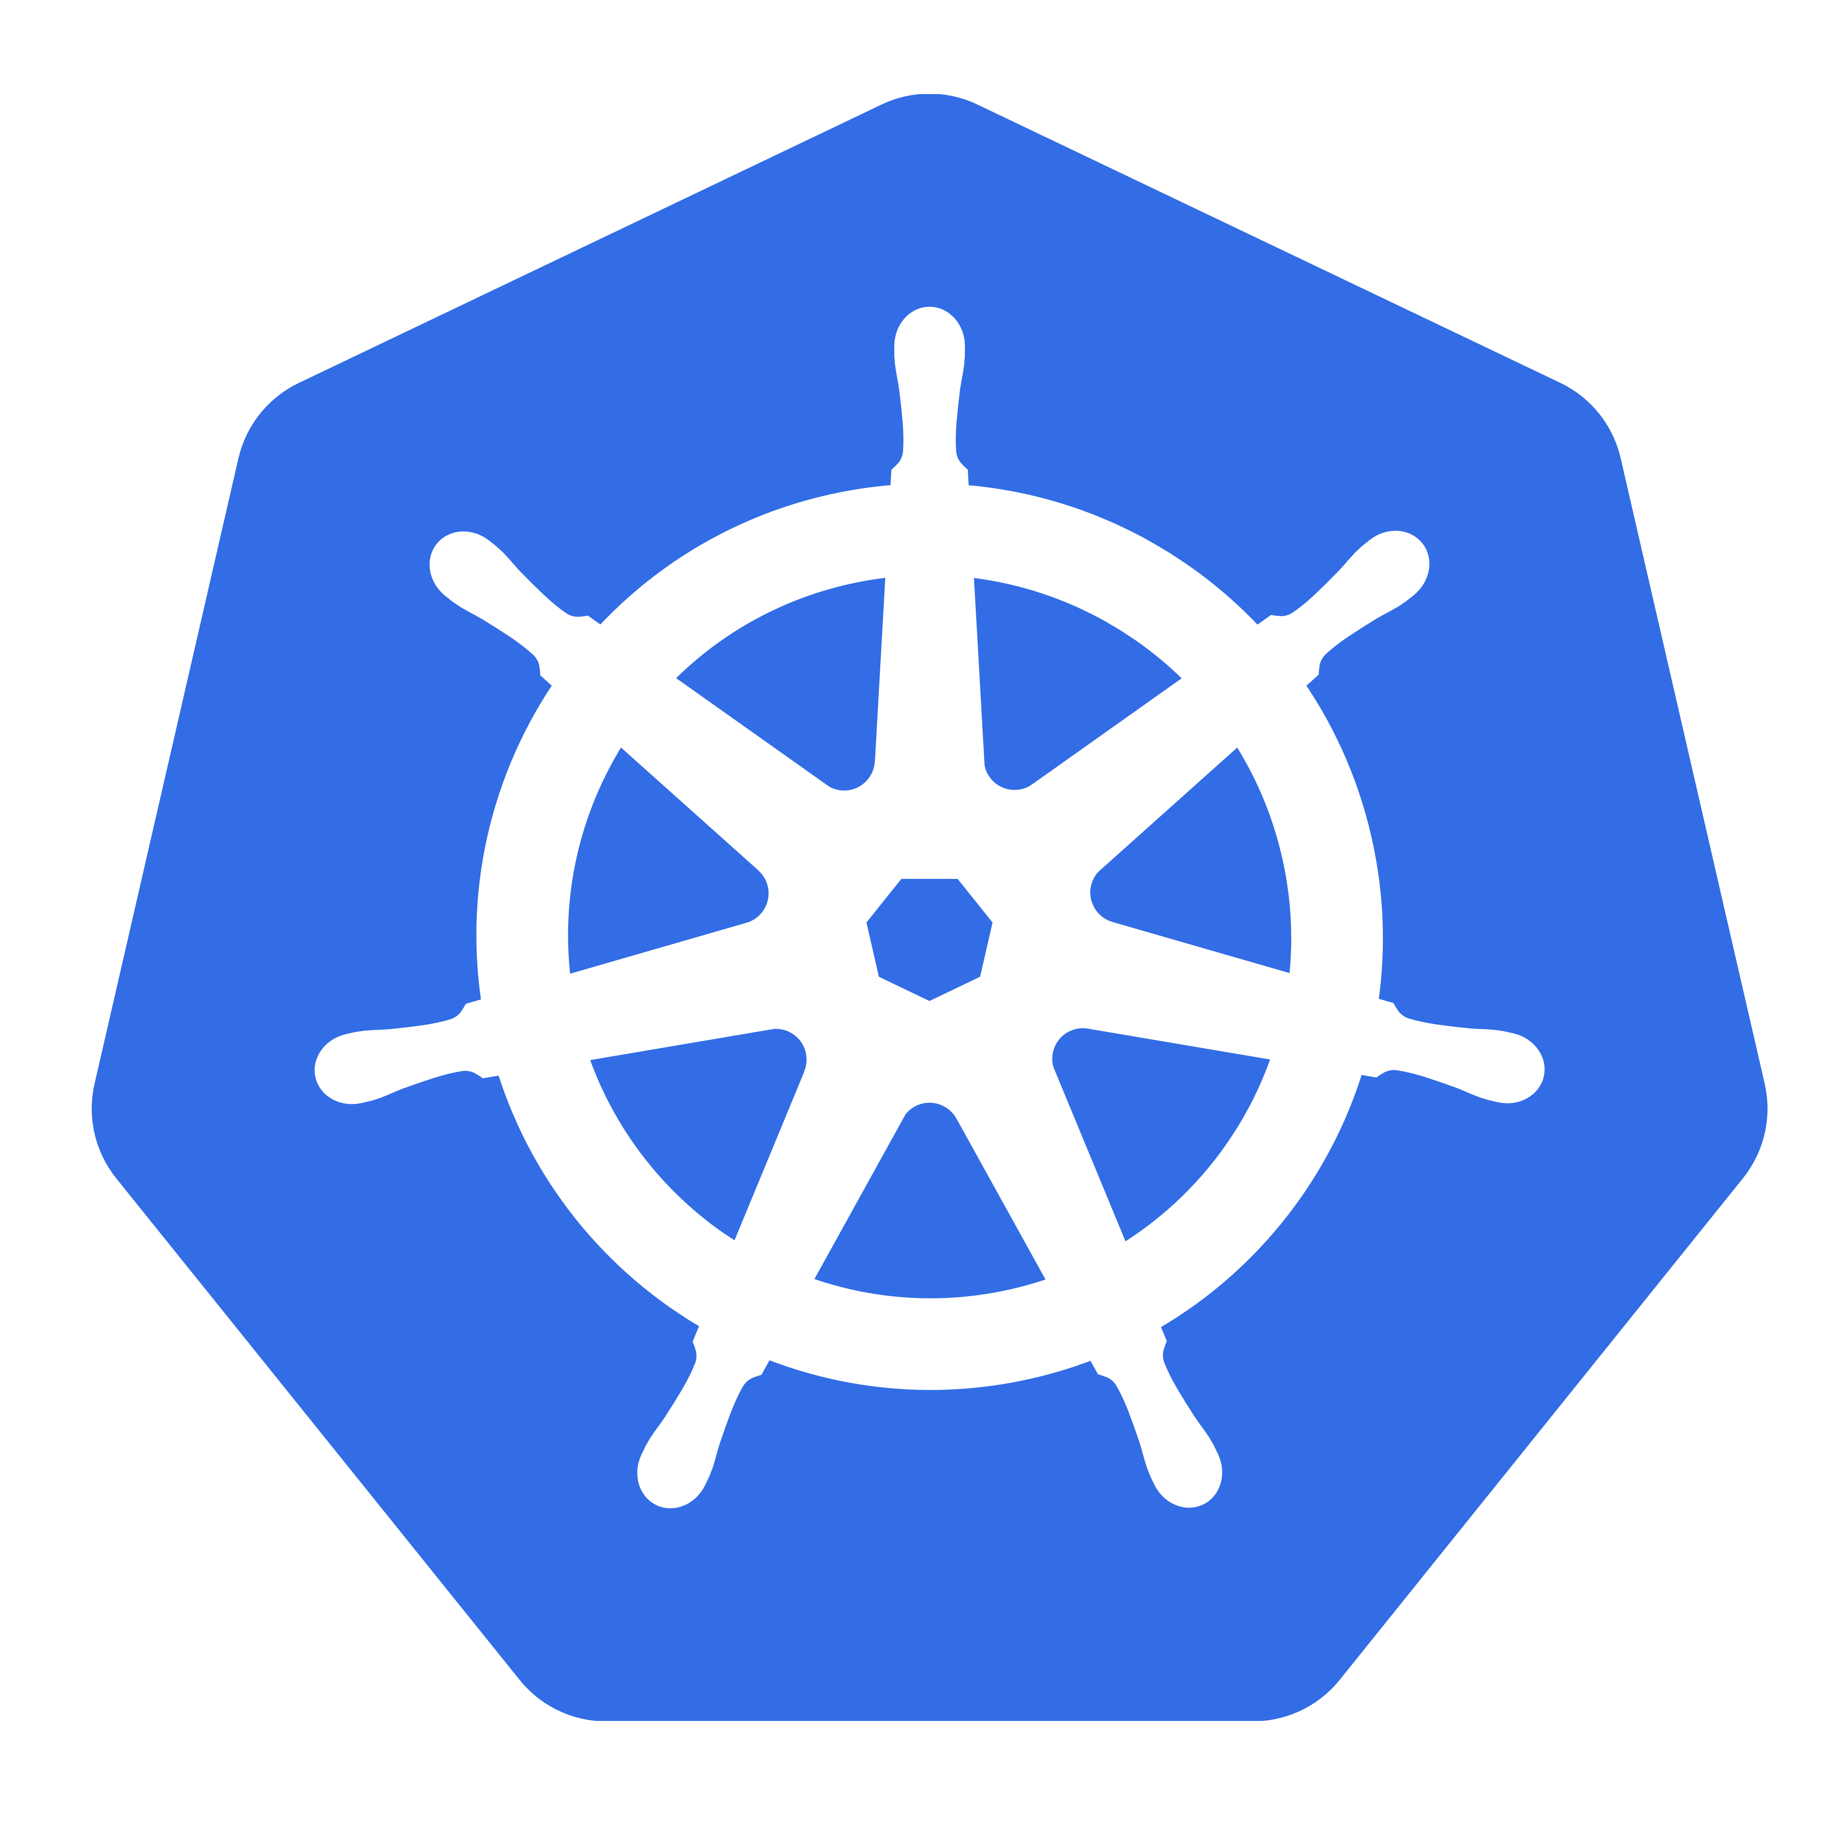

Slide 2
What is KUBERNETES?

Slide 3
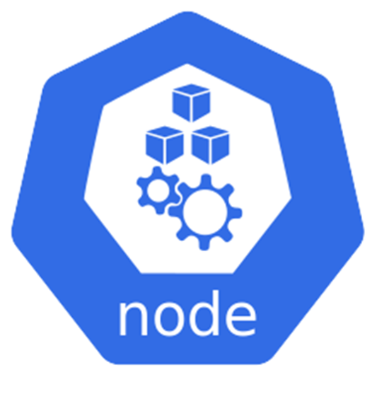
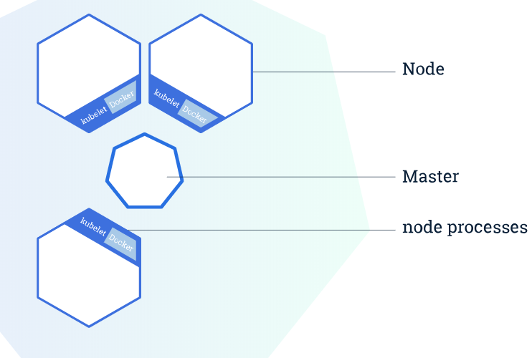

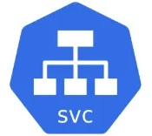
1.Official Definition
2.Problem Solution Case-Study
Why did K8s rise so fast?
What problems does it solve?
3.Basic Architecture
Master-Slave
K8s Processes
4.Basic Concepts
5.Example Config.

Slide 4

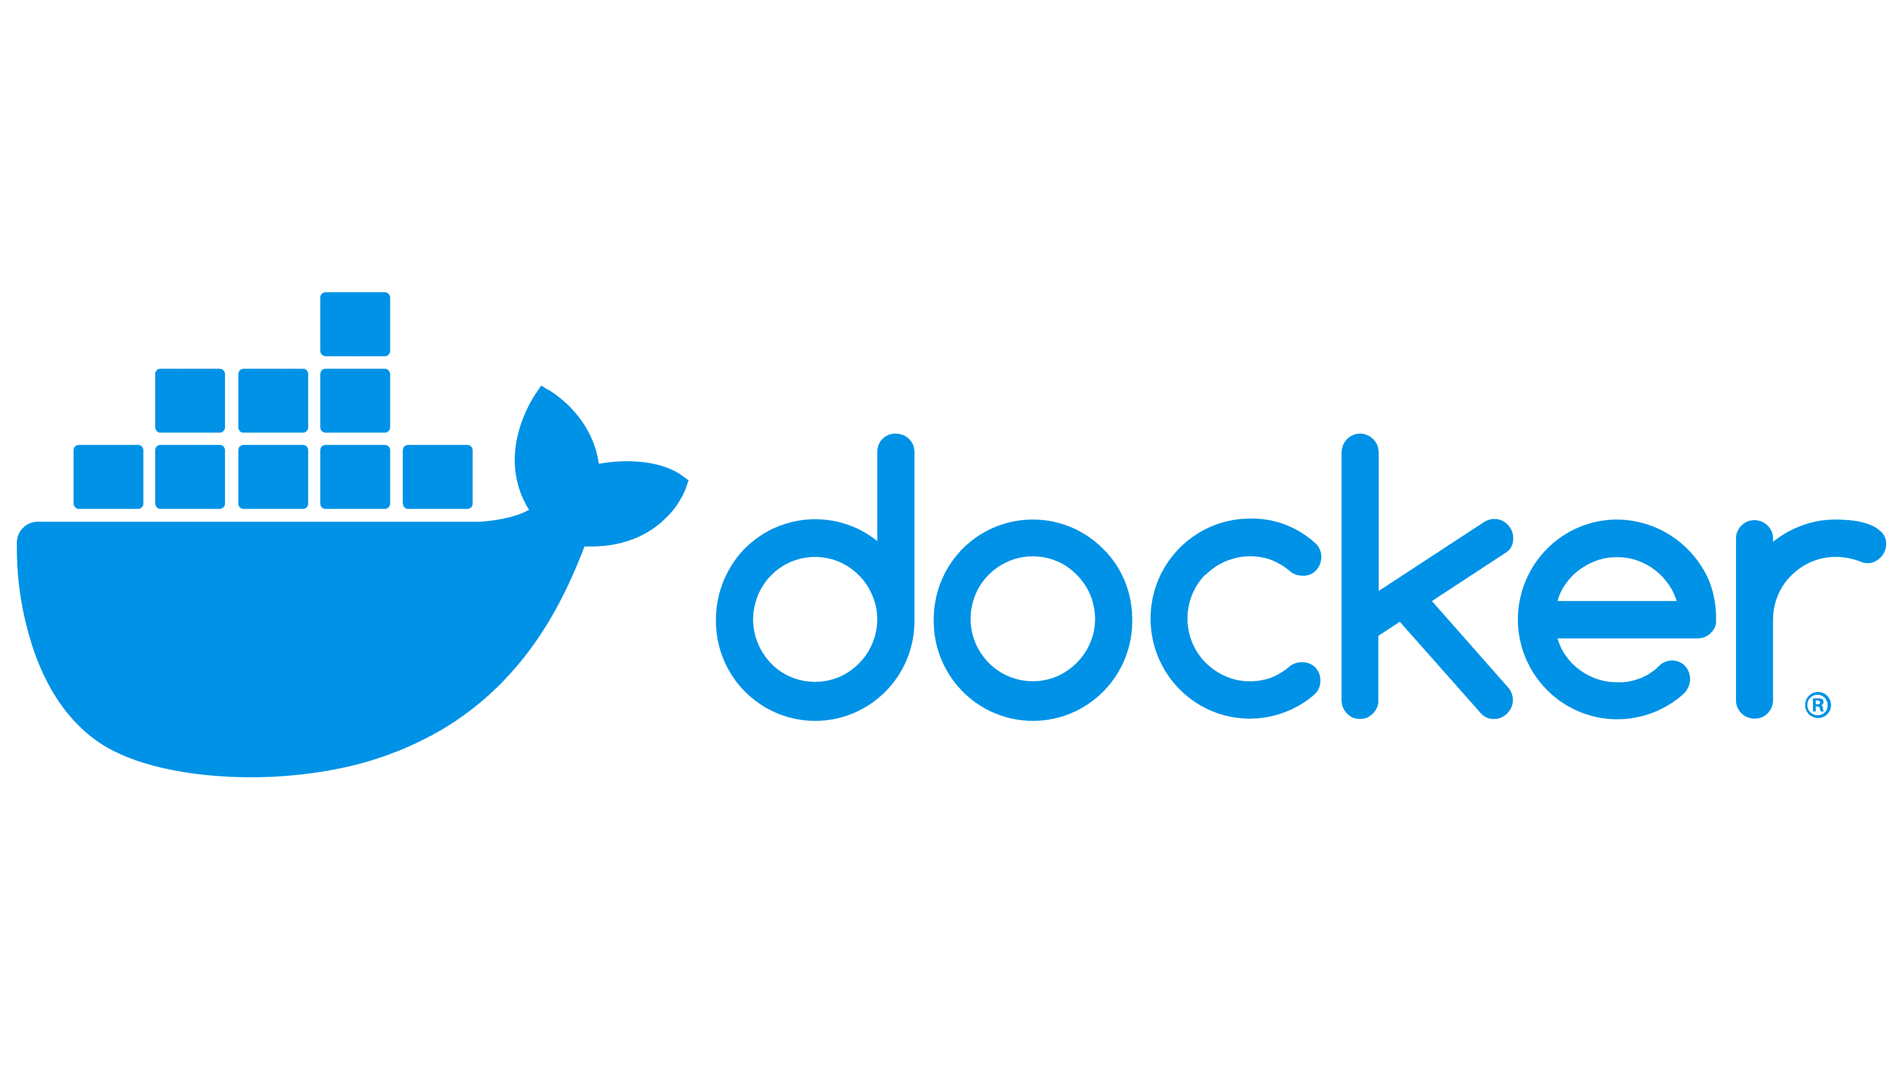
of Kubernetes
1.Official Definition
Open-source Container orchestration tool
Developed by Google
Helps manage containers

Slide 5
Official Definition of Kubernetes
Open-source Container orchestration tool
Developed by Google
Helps manage containers
Different enviornments
Physical
Virtual
Cloud

Slide 6

What problems does Kubernetes SOLVE??
What are tasks of
The container orchestration tool??

Slide 7
Trend from Monolith to Microservices

Slide 8

Trend from Monolith to Microservices

Slide 9
Trend from Monolith to Microservices

Slide 10
Trend from Monolith to Microservices
Container

Slide 11
Trend from Monolith to Microservices
Container

Slide 12



Managing Containers using 1.Scripts 2.Selfmade tools can be really complex.

Slide 13
Container Orchestration Tools offer:
High Availabilty or No downtime
Scalability or High performance
Disaster recovery - Backup & Restore

Slide 14
Kubernetes Architecture

Slide 15
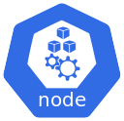

Kubernetes Architecture(Basic)
Master Node
kubelet
Primary ’node agent’
Worker Nodes

Slide 16

Kubernetes Architecture(Basic)
Master Node
Worker Nodes

Slide 17

Kubernetes Architecture(Basic)
Important k8s processes required for the cluster to function properly.
“Entry point to the cluster”
API server
Master Node

Slide 18
Kubernetes Architecture(Basic)
API server
UI
CLI
K8s Dashboard
API
Command line tools
Scripts & automations

Slide 19


Kubernetes Architecture(Basic)
API server
‘Entry Point’
ETCD
Controller Manager
Tracks the cluster
Scheduler
Ensures pod placement
K8s backing store

Slide 20
Kubernetes Architecture(Basic)
Master Node
Worker Nodes

Slide 21

Kubernetes Architecture(Basic)
Master Node
Virtual Network
Worker Nodes

Slide 22

Kubernetes Architecture(Basic)
Virtual Network
Master Node
Worker Nodes
One Unified powerful Machine

Slide 23
Kubernetes Basic Concepts

Slide 24



Kubernetes Basic Concepts
‘wrapper’
Pod
Container

Slide 25
Kubernetes Basic Concepts
Pod

Slide 26
Kubernetes Basic Concepts
‘1Pod’per Application
For e.g.
Database
Message broker
Server
Node.js Application

Slide 27
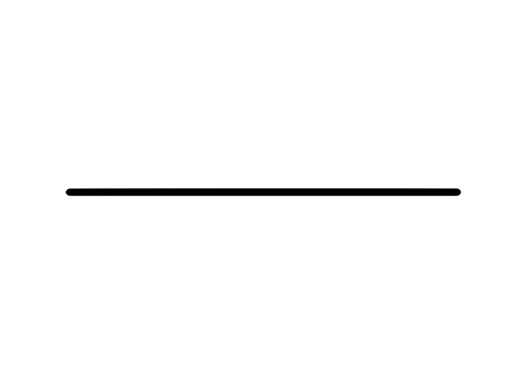
Kubernetes Basic Concepts
‘1Pod’per Application
IP 1
IP 3
IP 2

Slide 28
Kubernetes Basic Concepts
‘1Pod’per Application
IP 1
IP 3
IP 2

Slide 29

Kubernetes Basic Concepts
‘1Pod’per Application
IP 4
IP 3
IP 2

Slide 30
Kubernetes Basic Concepts
‘1Pod’per Application
Service 1
Service 3
Service 2

Slide 31
Kubernetes Configuration

Slide 32
Kubernetes Configuration
API server
UI
CLI
K8s Dashboard
API
Command line tools
Scripts & automations

Slide 33
Kubernetes Configuration
API server
YAML.
JSON.
UI
API
CLI
K8s Dashboard
Scripts & automations
Command line tools

Slide 34
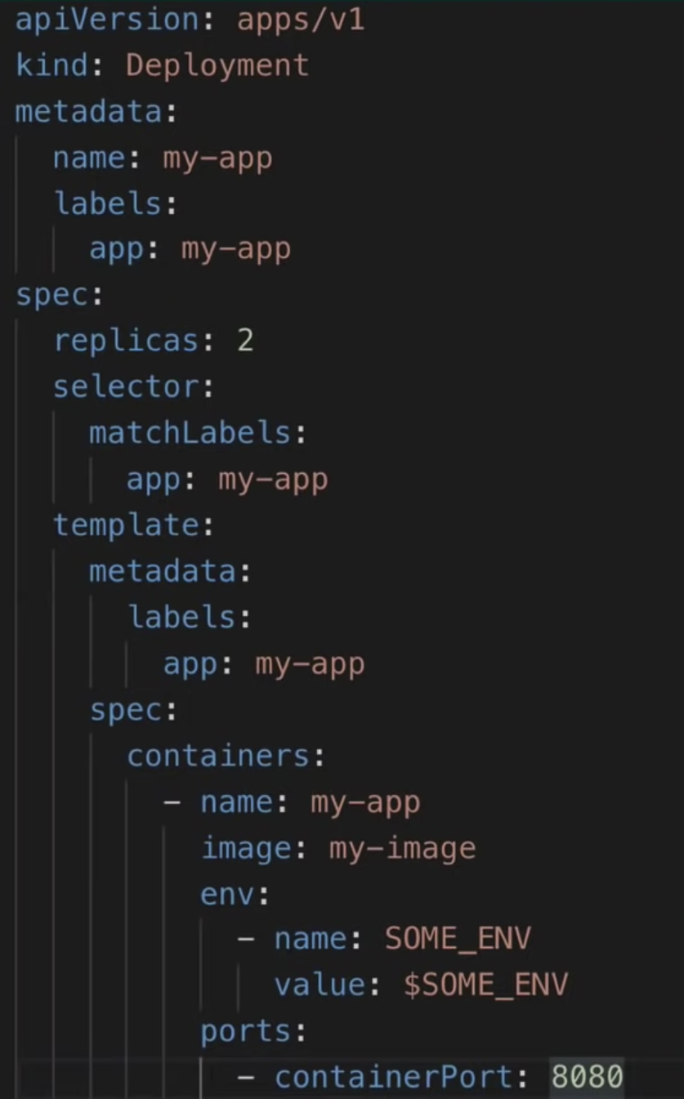
EXAMPLE CONFIG.
(YAML)
Declarative
IS == Should
Controller Manager
DESIRED STATE == ACTUAL STATE ??

Slide 35
Hope this sparks interest to further study Kubernetes and its implementation.
Thank you.

